Slide 1

Digital Portfolio
STUDENT NAME: Dhanushpriya D
REGISTER NO : 24131190500122005
NMID: FC15B562CE390549674F2F22AD0FD89
DEPARTMENT:BCA 2nd year
COLLEGE NAME: Government Arts and science college tittagudi 606106
UNIVERSITY: Annamalai University

Slide 2
PROJECT TITLE
DIGITED PORTFOLIO

Slide 3


AGENDA
Problem Statement
Project Overview
End Users
Tools and Technologies
Portfolio design and Layout
Features and Functionality
Results and Screenshots
Conclusion
Github Link
3/21/2024 Annual Review

Slide 4

PROBLEM STATEMENT
Students and professionals struggle to present their skills effectively a digital portfolio provides a structure solution.

Slide 5

PROJECT OVERVIEW
The project builds a personal portfolio website.
IIt organized education, skills and projects neatly.

Slide 6

WHO ARE THE END USERS?
Students preparing resumes job seekrs applying for opportunities.
Professionals showcasing expertise.

Slide 7

TOOLS AND TECHNIQUES
HTML for structure.
CSS for design and styling.
JavaScript for interactivity.

Slide 8
POTFOLIO DESIGN AND LAYOUT
Clean and simple layoutr.
Navigation-friendly sections.
Responsive for all devices.
8

Slide 9
FEATURES AND FUNCTIONALITY
Interactive menus.
Project gallery with details.
Contact form integration.

Slide 10
FEATURES AND FUNCTIONALITY
Interactive menus.
Project gallery with details.
Contact form integration.

Slide 11
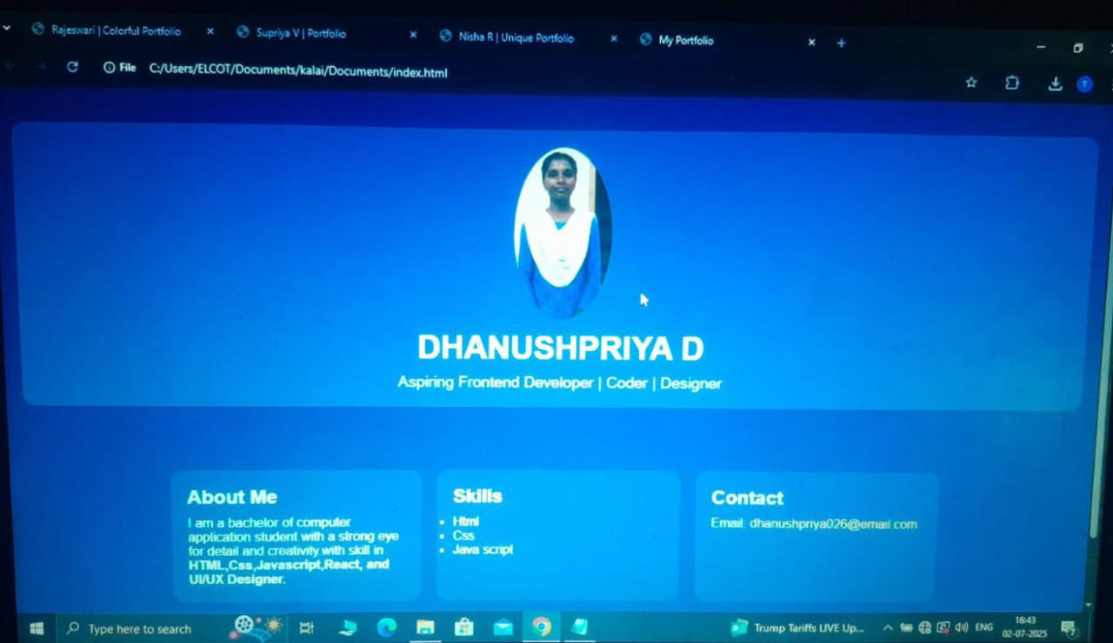

RESULTS AND SCREENSHOTS
3/21/2024 Annual Review
11

Slide 12
CONCLUSION
Tha portfolio improves self-presentation.
It supports career opportunities.
It is easy to update anytime.
12

Slide 13
GITHUB LINK
https://github.com/dhanushpriya026-creator/DhanushpriyaD-TNSDC-FWD-DP.git
13

